Slide 1
Multi-agent pathfinding in Kiva Systems
Phillip Wong
Daniel Harabor & Pierre Le Bodic
Notes:
Morning / Afternoon ~ Name - Phillip Wong ~ Proj: MAPF ~ Along with 2, Dan, Pierre

Slide 2
Multi-agent pathfinding
For all agents find a path to the goal
Ensure no conflicts
a1 |  |  | a2
g2 |  |  | g1
Notes:
Finding a path for all agent from their location to their goal

Slide 3
Multi-agent pathfinding
a1 |  |  | a2
g2 |  |  | g1

Slide 4
Multi-agent pathfinding
a1 |  | a2
g2 |  |  | g1

Slide 5
Multi-agent pathfinding
a1 | a2
g2 |  |  | g1

Slide 6
Multi-agent pathfinding
a1
g2 | a2 |  | g1

Slide 7
Multi-agent pathfinding
 | a1
a2 |  |  | g1

Slide 8
Multi-agent pathfinding
 |  | a1
a2 |  |  | g1

Slide 9
Multi-agent pathfinding
 |  |  | a1
a2 |  |  | g1

Slide 10
Multi-agent pathfinding
a2 |  |  | a1

Slide 11
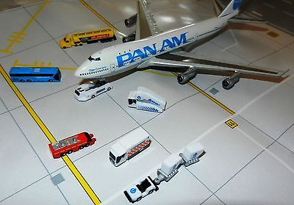
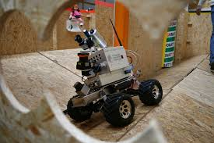
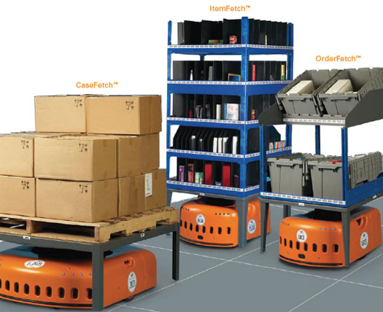
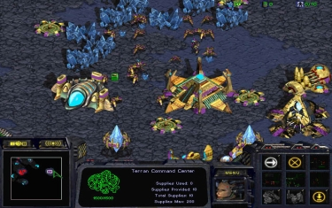
Motivation
Video games
Logistics
Robotics
Kiva Systems

Slide 12
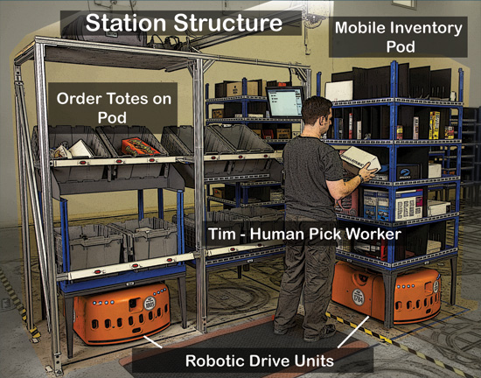
Kiva Systems
AKA Amazon Robotics
Large scale 1000+ robots
Put gif here
Notes:
Order a product from amazon, day arrival => kiva system will * process order * get the required inventory which is located around the warehouse * and packing it into a box

Slide 13
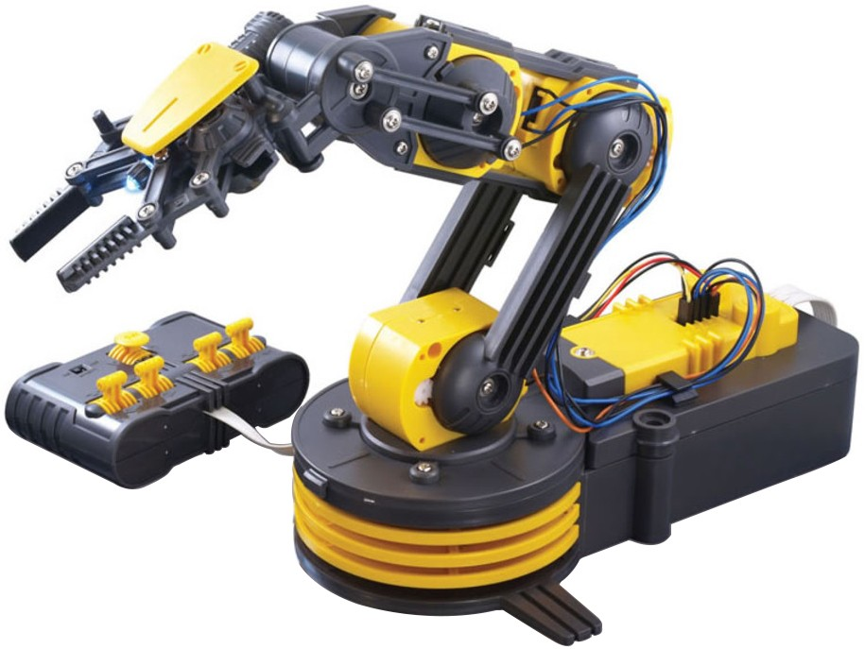

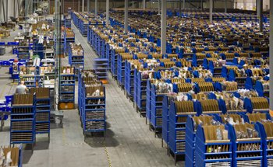
Areas within Kiva Systems
Multiagent pathfinding
Replenishment
Robot allocation
Automated Picking
Warehouse Layout
Notes:
Scheduling problem
* Replenishment of parts and battery
* deciding which picking station is free
* drive allocation
Robotics – automated picking
Optimization
* Warehouse layout
MAPF

Slide 14
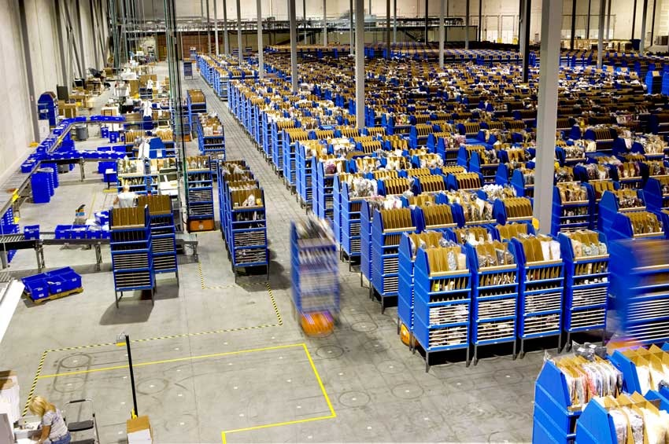
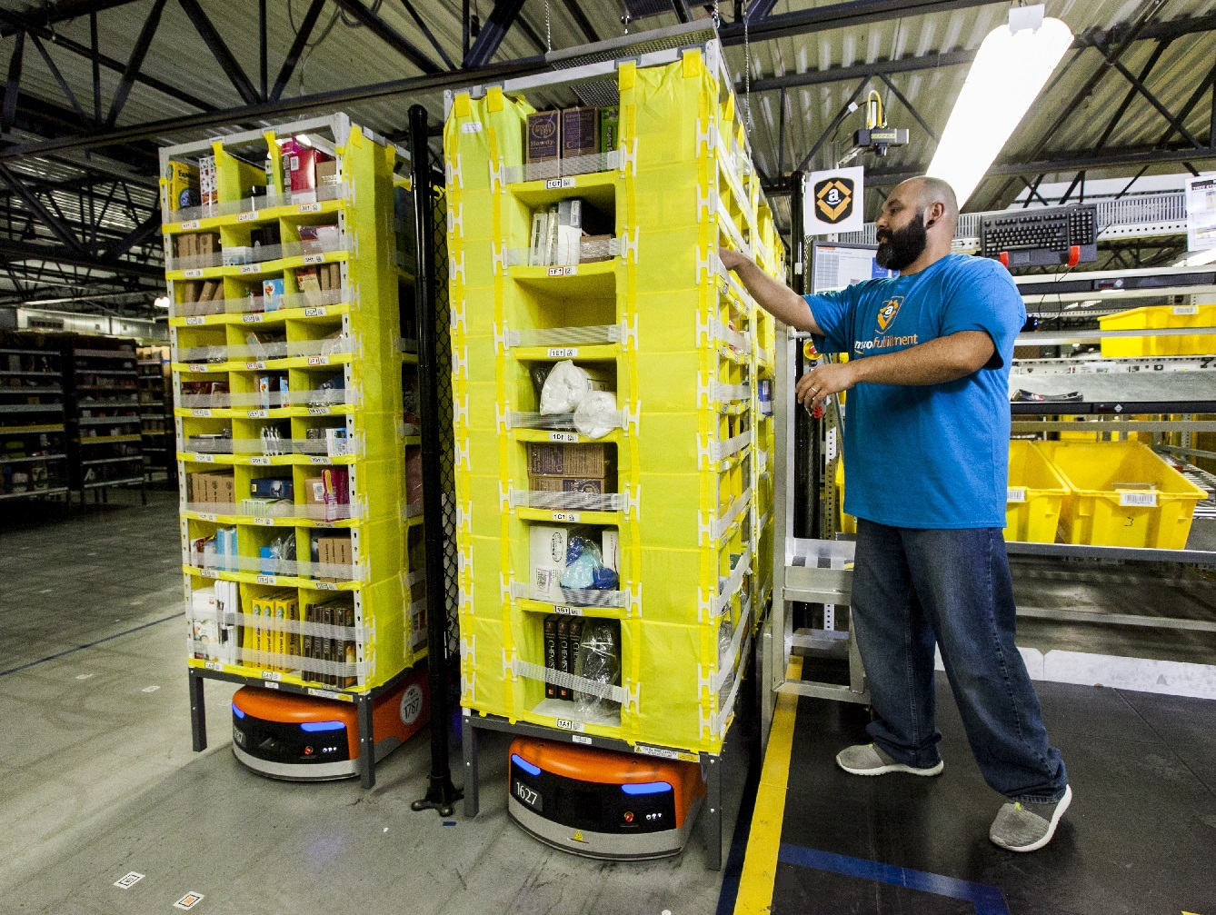
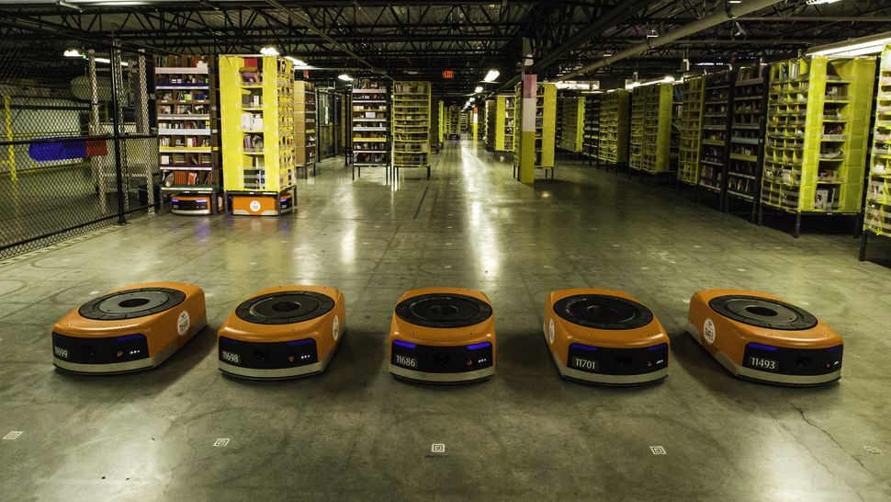
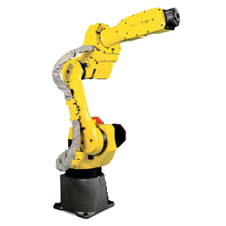
MAPF & part-to-picker system
Assign order
Bring ‘part’
Pick and pack

Slide 15
MAPF in Warehouse Automation
Warehouse Automation
Grid-based map (no diagonal movement)
Objective Functions
Makespan
Sum of cost
Down-time
Cooperative multi-agent pathfinding

Slide 16

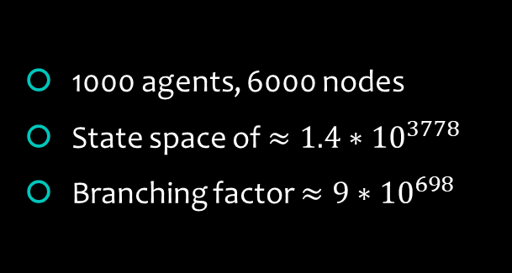
Is it a solved problem?
$k$ agents, $n$ nodes
$n^{k}$ state space
$5^{k}$ branching factor
1000 agents, 6000 nodes
State space of $≈1.4∗{10}^{3778}$
Branching factor ${≈9∗10}^{698}$
NP Hard
15 | 2 | 1 | 12
8 | 5 | 6 | 11
4 | 9 | 10 | 7
3 | 14 | 13
1 | 2 | 3 | 4
5 | 6 | 7 | 8
9 | 10 | 11 | 12
13 | 14 | 15
Notes:
State space: ways to place agents on the grid
5 actions {up down left right wait}

Slide 17
Why optimality?
Better starting point
Bounded suboptimal solution
Optimal = x timesteps
Suboptimal 3x timesteps

Slide 18
State of the art
Conflict Based Search (CBS)
Path collision <a1, a2, location, time>
Constraint <agent, location, time> not!
Perform Search
Find Conflicts
Apply Constraints

Slide 19
Resolving Conflicts
Perform Search
Find Conflicts
Apply Constraints
Cons:
1
2
3
 |  |  | g2
a2 |  |  | g1
 | a1
1 2 3 4
Notes:
Find a path for each agent
Identify conflicts between paths
Perform search again, reduce the number of conflicts

Slide 20
Resolving Conflicts
Perform Search
Find Conflicts
Apply Constraints
Cons:
1
2
3
 |  |  | g2
a2 |  |  | g1
 | a1
1 2 3 4
Notes:
Find a path for each agent
Identify conflicts between paths
Perform search again, reduce the number of conflicts

Slide 21
Resolving Conflicts
Perform Search
Find Conflicts
Apply Constraints
Cons:
1
2
3
 |  |  | g2
a2 |  |  | g1
 | a1 |  | s
1 2 3 4
Notes:
Find a path for each agent
Identify conflicts between paths
Perform search again, reduce the number of conflicts

Slide 22
Resolving Conflicts
Perform Search
Find Conflicts
Apply Constraints
Cons:
Cons: {A1, (2,2), 1}
Cons: {A2, (2,2), 1}
1
2
3
 |  |  | g2
a2 |  |  | g1
 | a1
1 2 3 4
Notes:
Find a path for each agent
Identify conflicts between paths
Perform search again, reduce the number of conflicts

Slide 23
Resolving Conflicts
Perform Search
Find Conflicts
Apply Constraints
Cons:
Cons: {A1, (2,2), 1}
Cons: {A2, (2,2), 1}
1
2
3
 |  |  | g2
a2 |  |  | g1
 | a1
1 2 3 4
Notes:
Find a path for each agent
Identify conflicts between paths
Perform search again, reduce the number of conflicts

Slide 24
Resolving Conflicts
Perform Search
Find Conflicts
Apply Constraints
Cons:
Cons: {A1, (2,2), 1}
Cons: {A2, (2,2), 1}
1
2
3
 |  |  | g2
a2 |  |  | g1
 | a1
1 2 3 4
Notes:
Find a path for each agent
Identify conflicts between paths
Perform search again, reduce the number of conflicts

Slide 25
Resolving Conflicts
Perform Search
Find Conflicts
Apply Constraints
Cons:
Cons: {A1, (2,2), 1}
Cons: {A2, (2,2), 1}
Cons: {A1, (2,2), 1} Cons: {A1, (3,2), 2}
Cons: {A1, (2,2), 1} Cons: {A2, (3,2), 2}
1
2
3
 |  |  | g2
a2 |  |  | g1
 | a1
1 2 3 4
Notes:
Find a path for each agent
Identify conflicts between paths
Perform search again, reduce the number of conflicts

Slide 26
Resolving Conflicts
Perform Search
Find Conflicts
Apply Constraints
Cons:
Cons: {A1, (2,2), 1}
Cons: {A2, (2,2), 1}
Cons: {A1, (2,2), 1} Cons: {A1, (3,2), 2}
Cons: {A1, (2,2), 1} Cons: {A2, (3,2), 2}
1
2
3
 |  |  | g2
a2 |  |  | g1
 | a1
1 2 3 4
Notes:
Find a path for each agent
Identify conflicts between paths
Perform search again, reduce the number of conflicts

Slide 27
Resolving Conflicts
Perform Search
Find Conflicts
Apply Constraints
Cons:
Cons: {A1, (2,2), 1}
Cons: {A2, (2,1), 1}
Cons: {A1, (2,2), 1} Cons: {A1, (3,2), 2}
Cons: {A1, (2,2), 1} Cons: {A2, (3,2), 2}
1
2
3
 |  |  | g2
a2 |  |  | g1
 | a1
1 2 3 4
Notes:
Find a path for each agent
Identify conflicts between paths
Perform search again, reduce the number of conflicts

Slide 28
CBS and Bypassing
Cons:
Cons: {A1, (2,2), 1}
Cons: {A2, (2,2), 1}
Cons: {A1, (2,2), 1} Cons: {A1, (3,2), 2}
Cons: {A1, (2,2), 1} Cons: {A2, (3,2), 2}
 |  |  | a2
a2 |  |  | a1
 | a1
Compare children in the constraint tree
Choose path with least number of conflicts
Notes:
Find a path for each agent
Identify conflicts between paths
Perform search again, reduce the number of conflicts

Slide 29
Mixed Integer programming
Branch and bound
Highly optimized solvers
minimize 5x + 10y
subject to
x > 3
y < 5

Slide 30

Express
Solve
Output
minimize x + y
subject to
x > 2
y < 5
x = 3
y = 0
SCIP solver

Slide 31
6
5
4
3
2
1
0
 | 0 | 1 | 2 | 3 | 4 | 5 | 6
minimize x + y
subject to
x > 2
y < 5

Slide 32
6
5
4
3
2
1
0
 | 0 | 1 | 2 | 3 | 4 | 5 | 6
minimize x + y
subject to
x > 2
y < 5

Slide 33
6
5
4
3
2
1
0
 | 0 | 1 | 2 | 3 | 4 | 5 | 6
minimize x + y
subject to
x > 2
y < 5

Slide 34
6
5
4
3
2
1
0
 | 0 | 1 | 2 | 3 | 4 | 5 | 6
minimize x + y
subject to
x > 2
y < 5

Slide 35
6
5
4
3
2
1
0
 | 0 | 1 | 2 | 3 | 4 | 5 | 6
minimize x + y
subject to
x > 2
y < 5

Slide 36
Branch and price
Generate Mixed Integer Program
Run solver
Receive solution
Place a ‘price’ solution
Generate more columns

Slide 37
Independence detection
Detect independent groups
Solve({a3, a4})
Solve({a2, a1})
a4 |  |  | a3
a3 |  |  | g4
 |  |  | g2
a2 |  |  | g1
 | a1

Slide 38
Operator Decomposition
Ignore surplus paths?
Solve({a3, a4})
 |  |  |  | g2
 | a2 |  |  | g1
 |  | a1

Slide 39
Previous work in MIP
Work by Jingjin Yu and Steven M. LaVelle
Multi-agent Path Planning and Network Flow
Planning Optimal Paths for Multiple Robots on Graphs

Slide 40
Contributions
Single agent pathfinding
Linear Programming
Branch and price
Jump Point Search
Compressed Path Databases

Slide 41
Current progress
Warehouse Simulation
Picking station
Drive Units
Order assignment
Single agent pathfinding (A*)
Learning Integer Programming

Slide 42
Simulation

Slide 43
Expected outcomes?
Fleet size reduced by up to 50%

Slide 44
Future Work

Slide 45
Thanks!

